Slide 1
Model Calibration

Slide 2
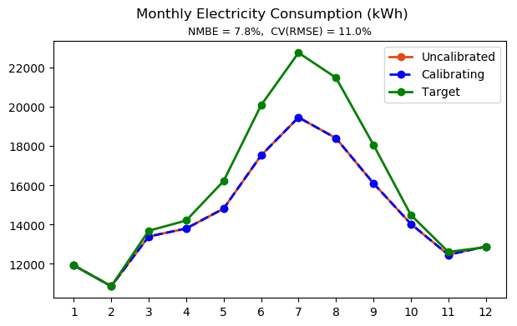
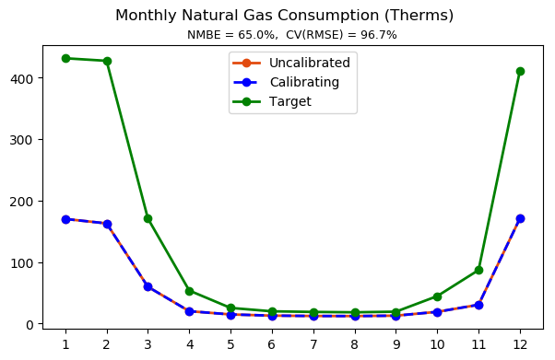
Initial state

Slide 3
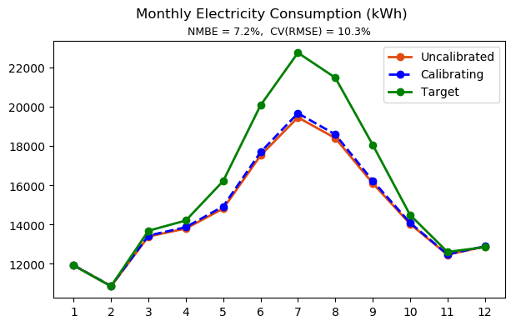
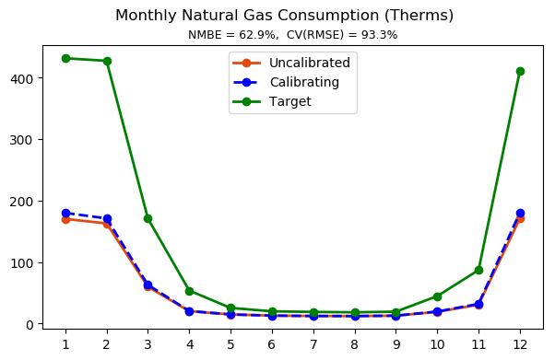
Manual Calibration – model tuning
Step 1
Exterior wall thermal conductivity x 1.5
Exterior wall thickness x 0.8

Slide 4
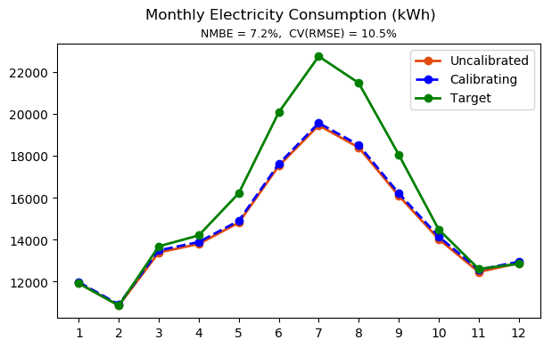
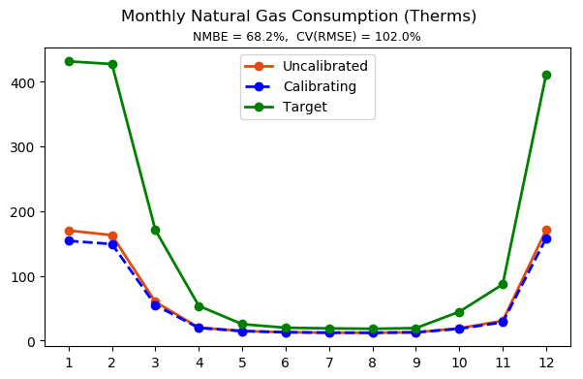
Manual Calibration – model tuning
Step 2
Exterior wall and floor thermal conductivity x 1.5
Exterior wall and floor thickness x 0.8

Slide 5


Manual Calibration – model tuning
Step 3
Exterior wall and floor thermal conductivity x 2
Exterior wall thickness x 0.8
Exterior glazing U-factor x 1.2
Exterior glazing SHGC x 0.8

Slide 6
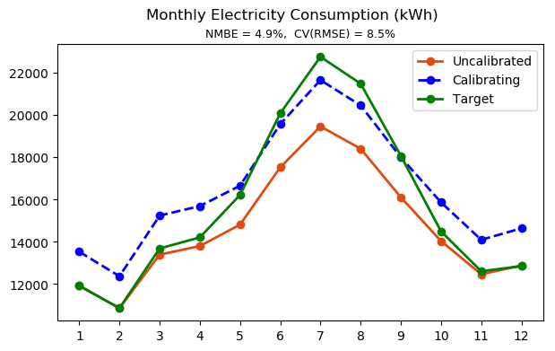
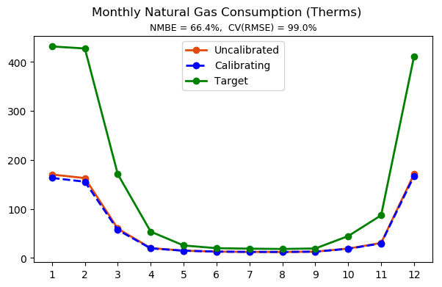
Manual Calibration – model tuning
Step 4
Exterior wall and floor thermal conductivity x 2
Exterior wall thickness x 0.8
Exterior glazing U-factor x 1.2
Exterior glazing SHGC x 0.8
Interior lighting and equipment power density x 1.2

Slide 7
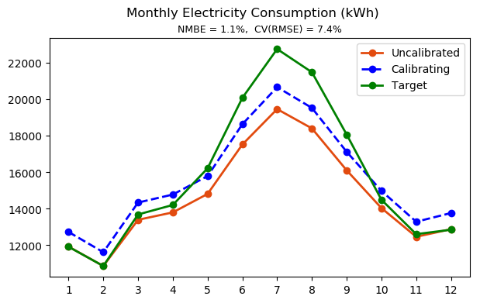
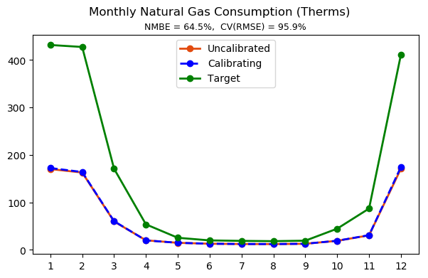
Manual Calibration – model tuning
Step 5
Exterior wall and floor thermal conductivity x 2
Exterior wall thickness x 0.8
Exterior glazing U-factor x 1.2
Exterior glazing SHGC x 0.8
Interior lighting and equipment power density x 1.1

Slide 8
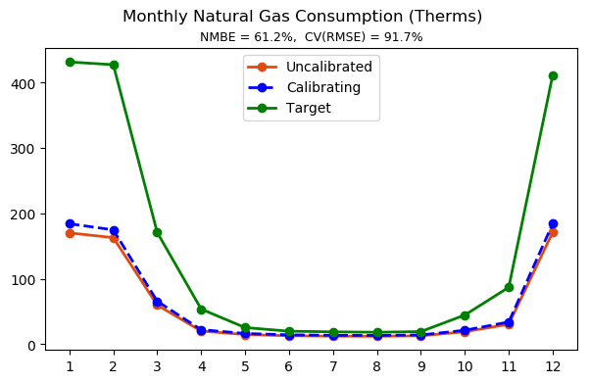
Manual Calibration – model tuning
Step 6
Exterior wall and floor thermal conductivity x 2
Exterior wall thickness x 0.8
Exterior glazing U-factor x 1.2
Exterior glazing SHGC x 0.8
Interior lighting and equipment power density x 1.1
Boiler and water heater efficiency x 0.9

Slide 9
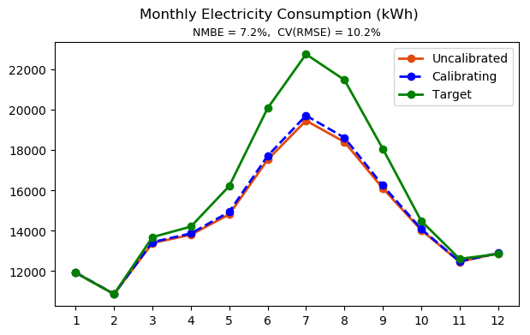
Manual Calibration – model tuning
Step 7
Exterior wall and floor thermal conductivity x 2
Exterior wall thickness x 0.8
Exterior glazing U-factor x 1.2
Exterior glazing SHGC x 0.8
Interior lighting and equipment power density x 1.1
Boiler and water heater efficiency x 0.9
Chiller COP x 0.9

Slide 10
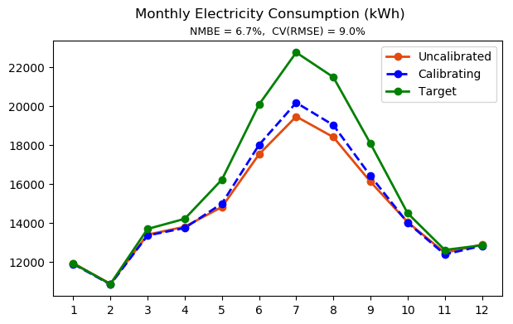
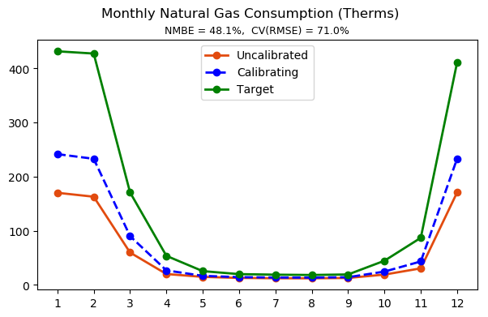
Manual Calibration – model tuning
Step 8
Exterior wall and floor thermal conductivity x 2
Exterior wall thickness x 0.8
Exterior glazing U-factor x 1.2
Exterior glazing SHGC x 0.8
Interior lighting and equipment power density x 1.1
Boiler and water heater efficiency x 0.9
Chiller COP x 0.9
Occupancy density x 1.5

Slide 11
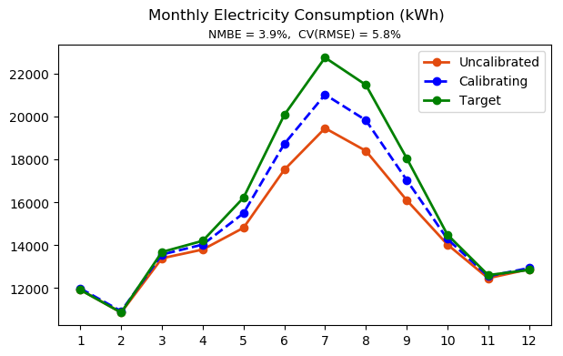
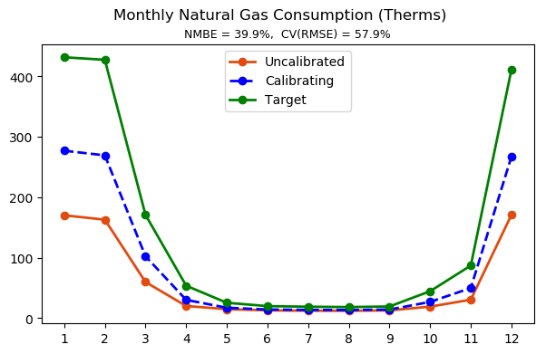
Manual Calibration – model tuning
Step 9
Exterior wall and floor thermal conductivity x 2
Exterior wall thickness x 0.8
Exterior glazing U-factor x 1.2
Exterior glazing SHGC x 0.8
Interior lighting and equipment power density x 1.1
Boiler and water heater efficiency x 0.9
Chiller COP x 0.9
Occupancy density x 1.5
Infiltration rate x 1.5

Slide 12
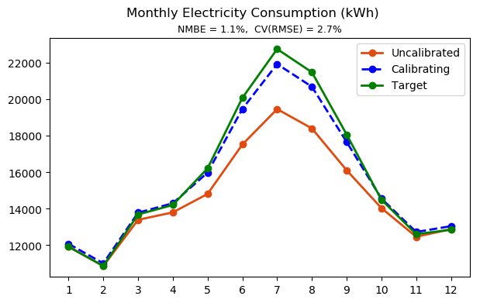
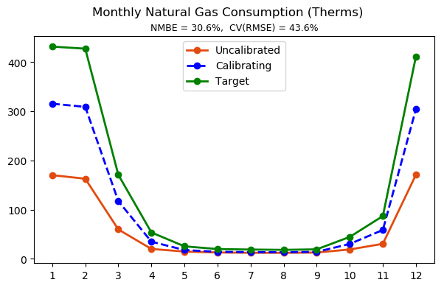
Manual Calibration – model tuning
Step 10
Exterior wall and floor thermal conductivity x 2
Exterior wall thickness x 0.8
Exterior glazing U-factor x 1.2
Exterior glazing SHGC x 0.8
Interior lighting and equipment power density x 1.1
Boiler and water heater efficiency x 0.9
Chiller COP x 0.9
Occupancy density x 1.5
Infiltration rate x 2

Slide 13
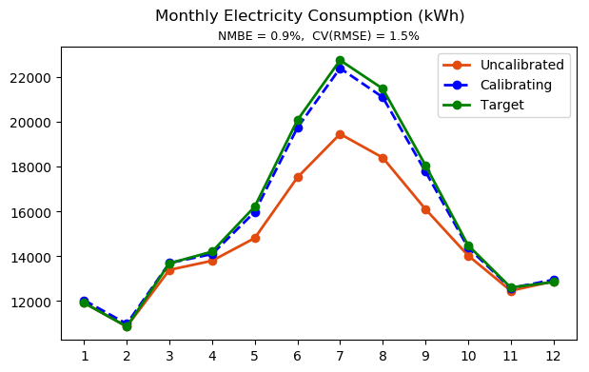
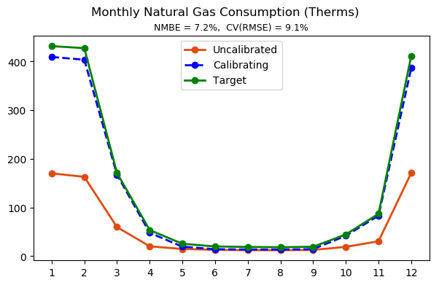
Manual Calibration – model tuning
Step 11
Exterior wall and floor thermal conductivity x 2
Exterior wall thickness x 0.8
Exterior glazing U-factor x 1.2
Exterior glazing SHGC x 0.8
Interior lighting and equipment power density x 1.1
Boiler and water heater efficiency x 0.9
Chiller COP x 0.9
Occupancy density x 1.5
Infiltration rate x 2
Outdoor air rate per person x 1.5

Slide 14
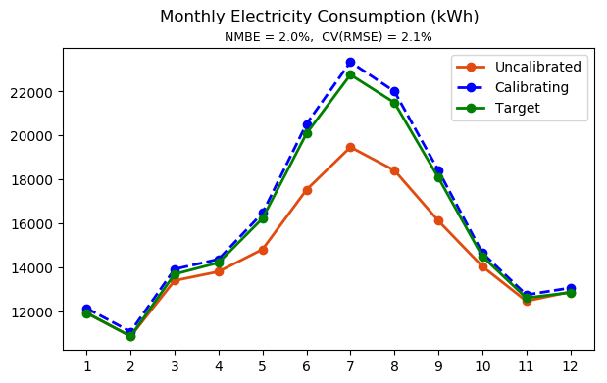
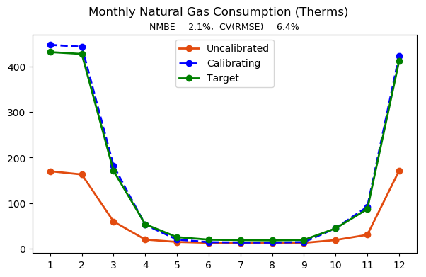
Manual Calibration – model tuning
Step 12
Exterior wall and floor thermal conductivity x 2
Exterior wall thickness x 0.8
Exterior glazing U-factor x 1.2
Exterior glazing SHGC x 0.8
Interior lighting and equipment power density x 1.1
Boiler and water heater efficiency x 0.9
Chiller COP x 0.9
Occupancy density x 1.5
Infiltration rate x 2.5
Outdoor air rate per person x 1.5

Slide 15
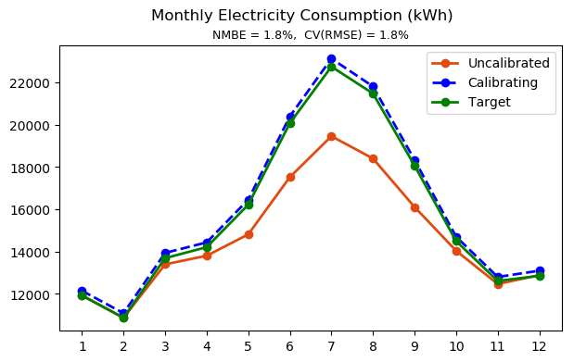

Manual Calibration – model tuning
Step 13
Exterior wall and floor thermal conductivity x 2
Exterior wall thickness x 0.8
Exterior glazing U-factor x 1.2
Exterior glazing SHGC x 0.8
Interior lighting and equipment power density x 1.1
Boiler and water heater efficiency x 0.9
Chiller COP x 0.9
Occupancy density x 1.5
Infiltration rate x 2.5
Outdoor air rate per person x 1.3

Slide 16
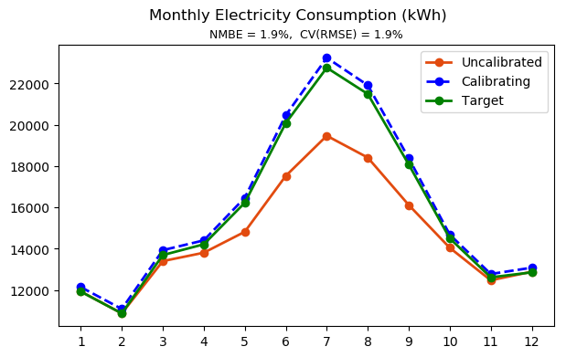
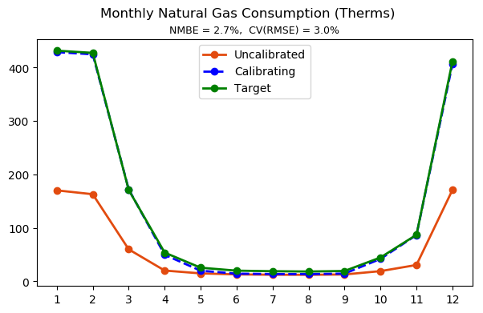
Manual Calibration – model tuning
Step 14
Exterior wall and floor thermal conductivity x 2
Exterior wall thickness x 0.8
Exterior glazing U-factor x 1.2
Exterior glazing SHGC x 0.8
Interior lighting and equipment power density x 1.1
Boiler and water heater efficiency x 0.9
Chiller COP x 0.9
Occupancy density x 1.5
Infiltration rate x 2.5
Outdoor air rate per person x 1.4

Slide 17
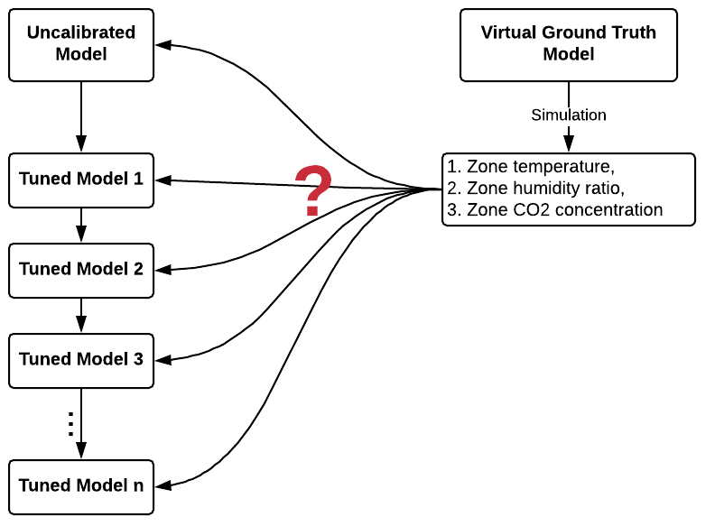
Hybrid Calibration – lessons learned
Important: which step to use inverse modeling?
Use it in early steps:
Building and system characteristics are highly uncertain, the inverse solution is meaningless.
The uncertainty of the inverse solution is huge.
Use it in late steps:
The inverse solution is more reliable.
The benefit to monthly calibration precision is marginal.
It benefits more in terms of calibration with high resolution (e.g., hourly, daily)

Slide 18
Hybrid Calibration – model tuning

Slide 19
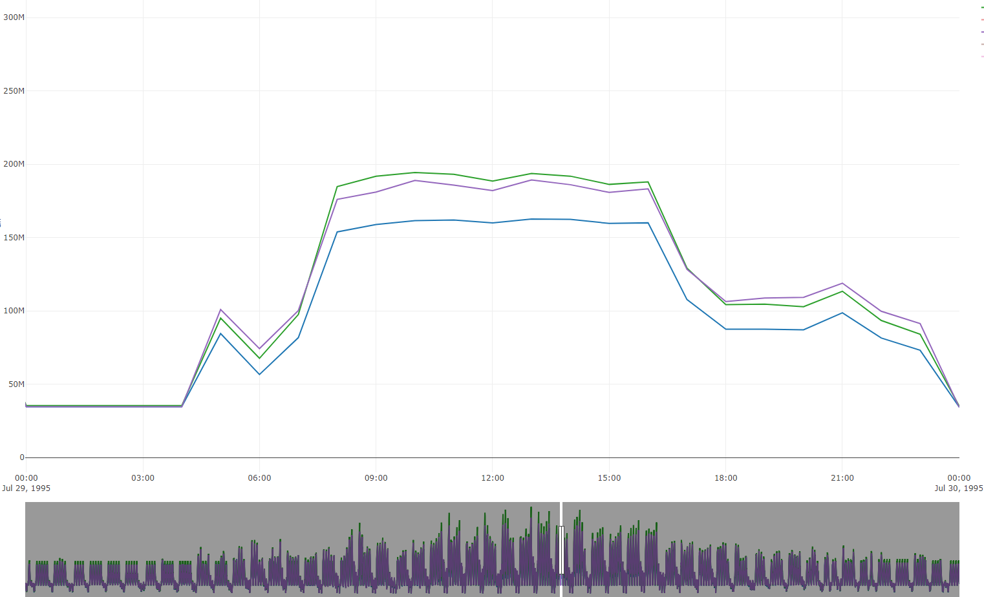
Comparison
Target (Ground Truth)
Calibrated
Uncalibrated

Slide 20
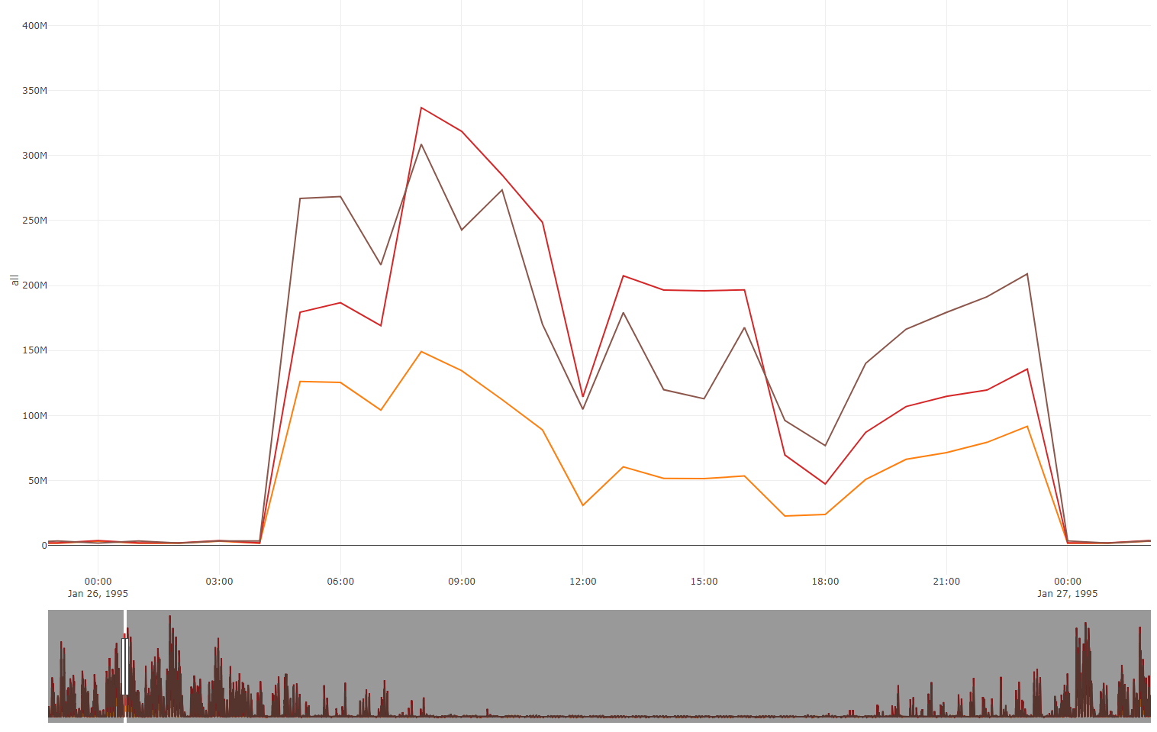
Comparison
Hourly gas consumption in heating season
Target (Ground Truth)
Calibrated
Uncalibrated

Slide 21
Manual Calibration – model tuning

Slide 22
Manual Calibration – model tuning

Slide 23
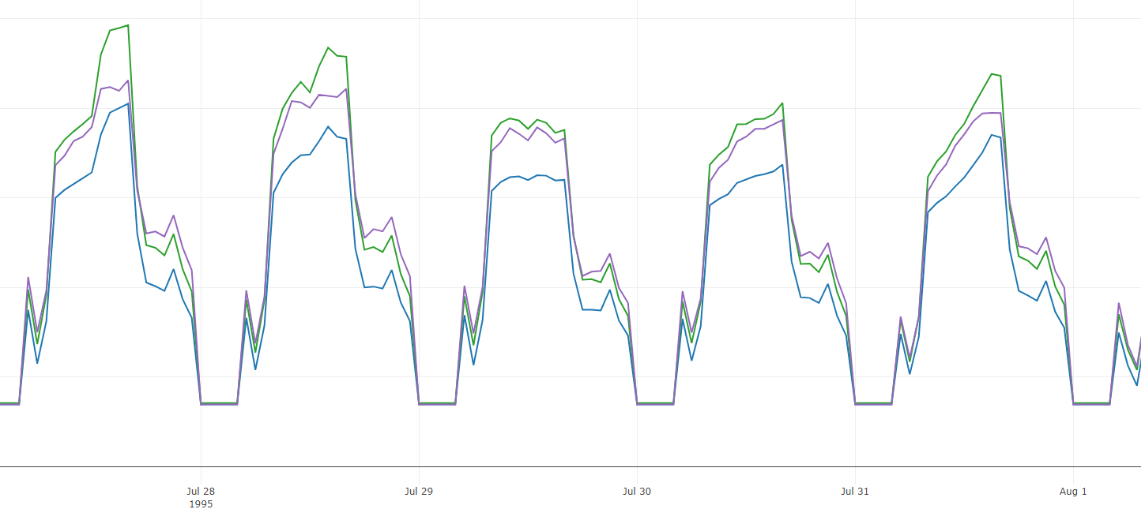
Manual Calibration – model tuning

